Slide 1
ROSETTA WORKSHOP
M. Ferla 2/8/2018

Slide 2
WARNING
NB. Powerpoint’s proclivity for changing hyphen minuses to en-dashes and apostrophes to directional quotes may have altered the code. Please Run search and replace for these (on Mac en dash, –, is alt+hyphen and em dash, —, is alt+shift+hyphen) on your copy of this document.

Slide 3
Rosetta overview
Force fields
Minimise energy
Gibbs free energy (∆G)
AMBER in NAMD
CHARMM in Gromacs
Talaris2013

Slide 4
Running Rosetta
Command line
Website (Rosie)
Some GUIs exist
Fold-it standalone
https://www.rosettacommons.org/software/academic/
Or Google Rosetta Commons
Username: Academic_User Password: Xry3x4
Wrong one
Again, wrong one
This one is right
Also wrong one

Slide 5
Details
The aim of modelling is to get a model whose prediction matched the effects seen in the lab.
Rosetta scores ∆G of the protein so will find the most stable version, which does not mean catalysis (cf. intermediate) or solubility at pH 7. Tag solubility may be a stronger factor say. Unfortunately, not much time has been spent modelling the variants in order to find what is the most accurate predictors.
The Rosetta documentation covers the basics. The applications that are most useful are:
Remodel: makes large scale changes, insertions, deletions and backbone wobbled mutants.
Relax: wobbles the protein to find best score, including PyMol mutants say.
Pmut_scan: gives the score for all possible single and double mutations, the output by default is –1 REU, but given a really bad negative threshold one gets a table of all mutants

Slide 6
Where is it?
say pwd is somewhere/rosetta_workshop/spyC_test and somewhere/rosetta
ROSETTAEXT=static.macosclangrelease
ROSETTA=../../rosetta/main/source/bin/
ROSETTADB=../../rosetta/main/database/
NB. Bad idea to have relative path, unless you are using external drive, here just example
run thusly:
$ROSETTA/relax.$ROSETTAEXT
-database $ROSETTADB
–s structure.pdb
@FileWithArgs

Slide 7

Relax
Minimises the energy with small movements (backbone too)
Must haves
-ex1
-ex1aro
-ex2
-extrachi_cutoff 1
-relax:thorough
-no_optH false
Catchers (will extain next slides)
-in:file:extra_res_fa GLH.params
-extra_res_cen GLH.params
-constraints:cst_fa_file iso.fixer.cst
-constraints:cst_fa_weight 5
Maybes
-mute basic core
-out:overwrite true
-out:prefix something-
-out:suffix –something
-nstruct 10
Play it safe… unneeded args get ignored
https://www.rosettacommons.org/docs/latest/application_documentation/structure_prediction/relax

Slide 8
Score
Gives the values of the various force field energies
.sc files for whole protein
Within .pdb for per residue
See https://github.com/matteoferla/rosetta-pymol for my script to make fa_total or fa_sol as b-factors (b-factor putty in PyMol)
Total is Rosetta Energy Unit (REU) not kcal/mol
Lots of values
fa_dun
fa_elec
fa_intra_rep
fa_rep
fa_sol
hbond_bb_sc
hbond_lr_bb
hbond_sc
hbond_sr_bb
omega
p_aa_pp
pro_close
rama
Ref
yhh_planarity
description
total_score
angle_constraint
atom_pair_constraint
coordinate_constraint
dihedral_constraint
dslf_fa13
fa_atr
https://www.rosettacommons.org/docs/latest/rosetta_basics/scoring/score-types

Slide 9
Pmut_scan_parallel
Scores each possible mutation
Pairs of mutations
Custom mutations, e.g. scanning with NCAA
-DDG_cutoff 999 #hack
-mute basic core
$ROSETTA/pmut_scan_parallel.$ROSETTAEXT -database $ROSETTADB -s protein.pdb @scanner.txt > scan_scores.txt
-output_mutant_structures true optional
-double_mutant_scan optional
https://www.rosettacommons.org/manuals/archive/rosetta3.4_user_guide/d0/d4a/pmut_scan_parallel.html

Slide 10
Ligand
Program supports CAA protonated at pH 8
HIE and HID forms of HIS, but not HIP
NCAA and cofactors need to be explicitly given
rosetta/main/database/ chemical/residue_type_sets/fa_standard/residue_types/

Slide 11
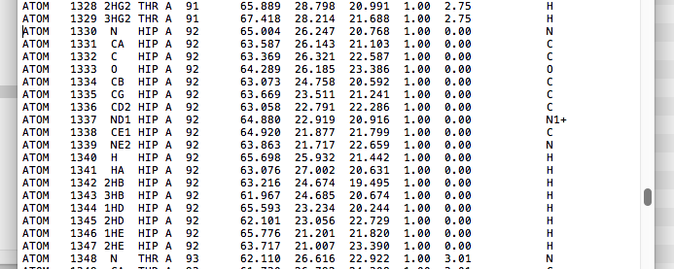
Double protonated histidine
.params in is the protonated folder
ATOM —not HETATM or
— in PDB

Slide 12
PDB FILES
PDB files can be opened in TextEdit/Notepad to reveal their workings (cf. PDB format). Each atom has a line (ATOM) and some atoms are explicitly connected with a CONECT line. This is not required or really read by Rosetta.
NB. The spaces in a PDB file are important.

Slide 13
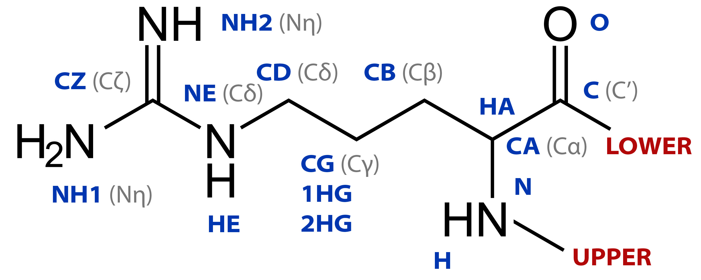
Atom names
The Greek letters are in Latin alphabet, cf. Γ and Δ
Modding? Forget hydrogens… -no_optH false

Slide 14
Adding NCAA
Before Relaxing one needs a pdb
Three ways:
PDB in TextEdit Search and replace -no_optH false argument
Remodel —nc <3 letter code> (does not work)
PyMol collage
PyMol mutate in a similar residue instead, in TextEdit delete or copypaste atoms changing their named but not caring about coordinated
PyMol PairFit with template, alter chain and segi to be the same, correct numbering, delete atoms. Save as one, edit file.

Slide 15
Isopeptide
Isopeptide bonds are stored in PDB files as LINK entries.
LINK NZ LYS A 31 CG ASP B 135 1555 1555 1.25
This states a bond between the atom named NZ of chain A K31 and D135 of chain B.
Rosetta >3.7
Annoyingly, the output of a Rosetta run strips the LINK —even with the header preservation tag on. So you have to add it back. Also rogue TER.
Replicated with a Lyx – asx bond

Slide 16
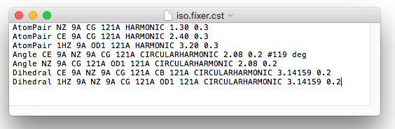
Straight isopeptide
Isopeptides are planar…
Pain to write: try sub-blocks!
WTF: Constraint file angles are in radian so 3.14 (1π) radians is 180°

Slide 17
First, Rosetta version ≥3.7 can handle this bond. But only between lysine and aspartate. As an isopeptide product is identical if the starting atom was an aspartate or an asparagine, so altering the latter to the former is required and makes no impact.

Slide 18
Glutamic acid
Rosetta .params has it double bonded (my fix).
No CONECT in PDB
unbond resn glh & name OE1, resn glh & name CD
bond resn glh & name OE1, resn glh & name CD, 2

Slide 19
Glutamic acid
The proton of glutamic acid hydrogen bonds with the isopeptide.
Special settings need to be made for the catalytic glutamic acid. Rosetta deals with residue solely in the protonation state they have at neutral pH and variant deprotonated and protonated states have to be encoded especially. A partial exception is monoprotonated histine for which both tautomers (HID and HIE) are tested, both not the biprotonated (HIP). In the case of glutamic acid the file in $rosetta_path/main/database/chemical/residue_type_sets/fa_standard/residue_types/protonation_states does not have a double bonded oxygen. So a tweak to the file is needed changing the CD–OE1 bond to BOND_TYPE CD OE1 2
For Relax and Remodel the params file need different flags, but to play it safe both can be given. If the glutamic acid is needed in the blueprint declare it as a NCAA.
-extra_res_fa GLH.new.params
-extra_res_cen GLH.new.params

Slide 20
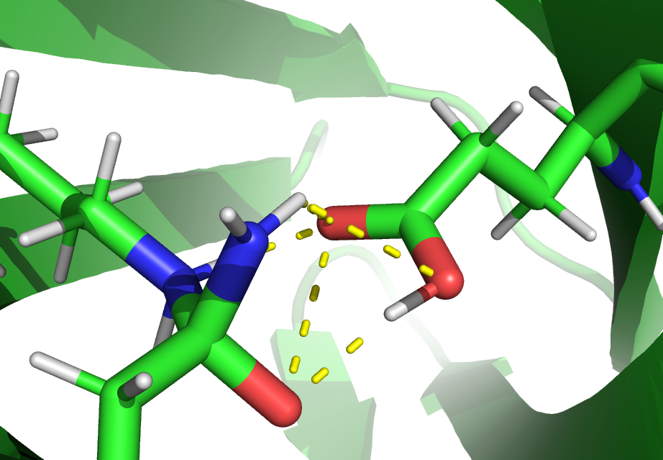
Intermediate
ASA.params for aspartate hemiaminal
lyx modded to have 2 protons
Constraint file (ASA-LYX.cst)
–250 REU → –240 REU → –254 REU

Slide 21
Linkers
Option A: just build and sculpt them in place in PyMol http://blog.matteoferla.com/2017/10/hacking-pdbs-for-fusion-protein.html
Option B: Remodel!

Slide 22
Remodel
Large scale remodelling based on blueprint file
-hb_lrbb 1.0
-rsigma 1.0
-ss_pair 1.0
-remodel:blueprint file.blu
-in:file:extra_res_fa and -extra_res_cen
https://www.rosettacommons.org/docs/latest/application_documentation/design/Remodel

Slide 23
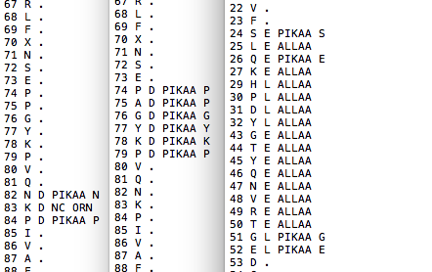
Blueprint
Perl script getBluePrintFromCoords.pl
Format is
Resi
Resn
SS
“.” keep backbone in place
“E” strand
“L” loop
“ H” helix
“D” any
Mod
PIK=pick AA
ALL=try all
NATRO etc.
Deletions: remove lines
Insertions: 0 X D PIKAA G

Slide 24
Anti-“segmentation fault 11” tips
Remember to wiggle preceeding and succeeding AA
New line at the end of file crashes it
Cannot add both N and C terminally simultaneously
Isolated blocks? Multiple jobs
Clustering?
Single chain only!
For catchers I sometimes make catcher-GGSGGSG-tag

Slide 25
Supercharge
List surface residues that can be safely mutated
Complex algorithm choices… try both
Suggestions are compatible (cf. pmut_scan)
Neutral epistatic mutations? pmut_scan -double_mutant_scan
NB. suggests DG and DP residue pairs

Slide 26
Docking
For small molecule ligand docking use ligand_dock
Depracated, but easier than XML scripting
For peptides flex_pept_dock…
Complicated fragment part, requires scripts
Online server helps

Slide 27
DIY ligands
Online manuals help
Get a mol2 or sdf file of your ligand
PyMol from crystal
Get smiles string and use either RDKit or https://cactus.nci.nih.gov/translate/
Optional Guassian QM MD
Get the python script molfile_to_params.py http://graylab.jhu.edu/pyrosetta/downloads/scripts/toolbox/molfile2params.tar.gz
If UPPER and LOWER, the x-link is CONNECT3
angles in °
Don’t worry about rotamers

